Slide 1

Advanced Git Concepts
www.herovired.com

Slide 2

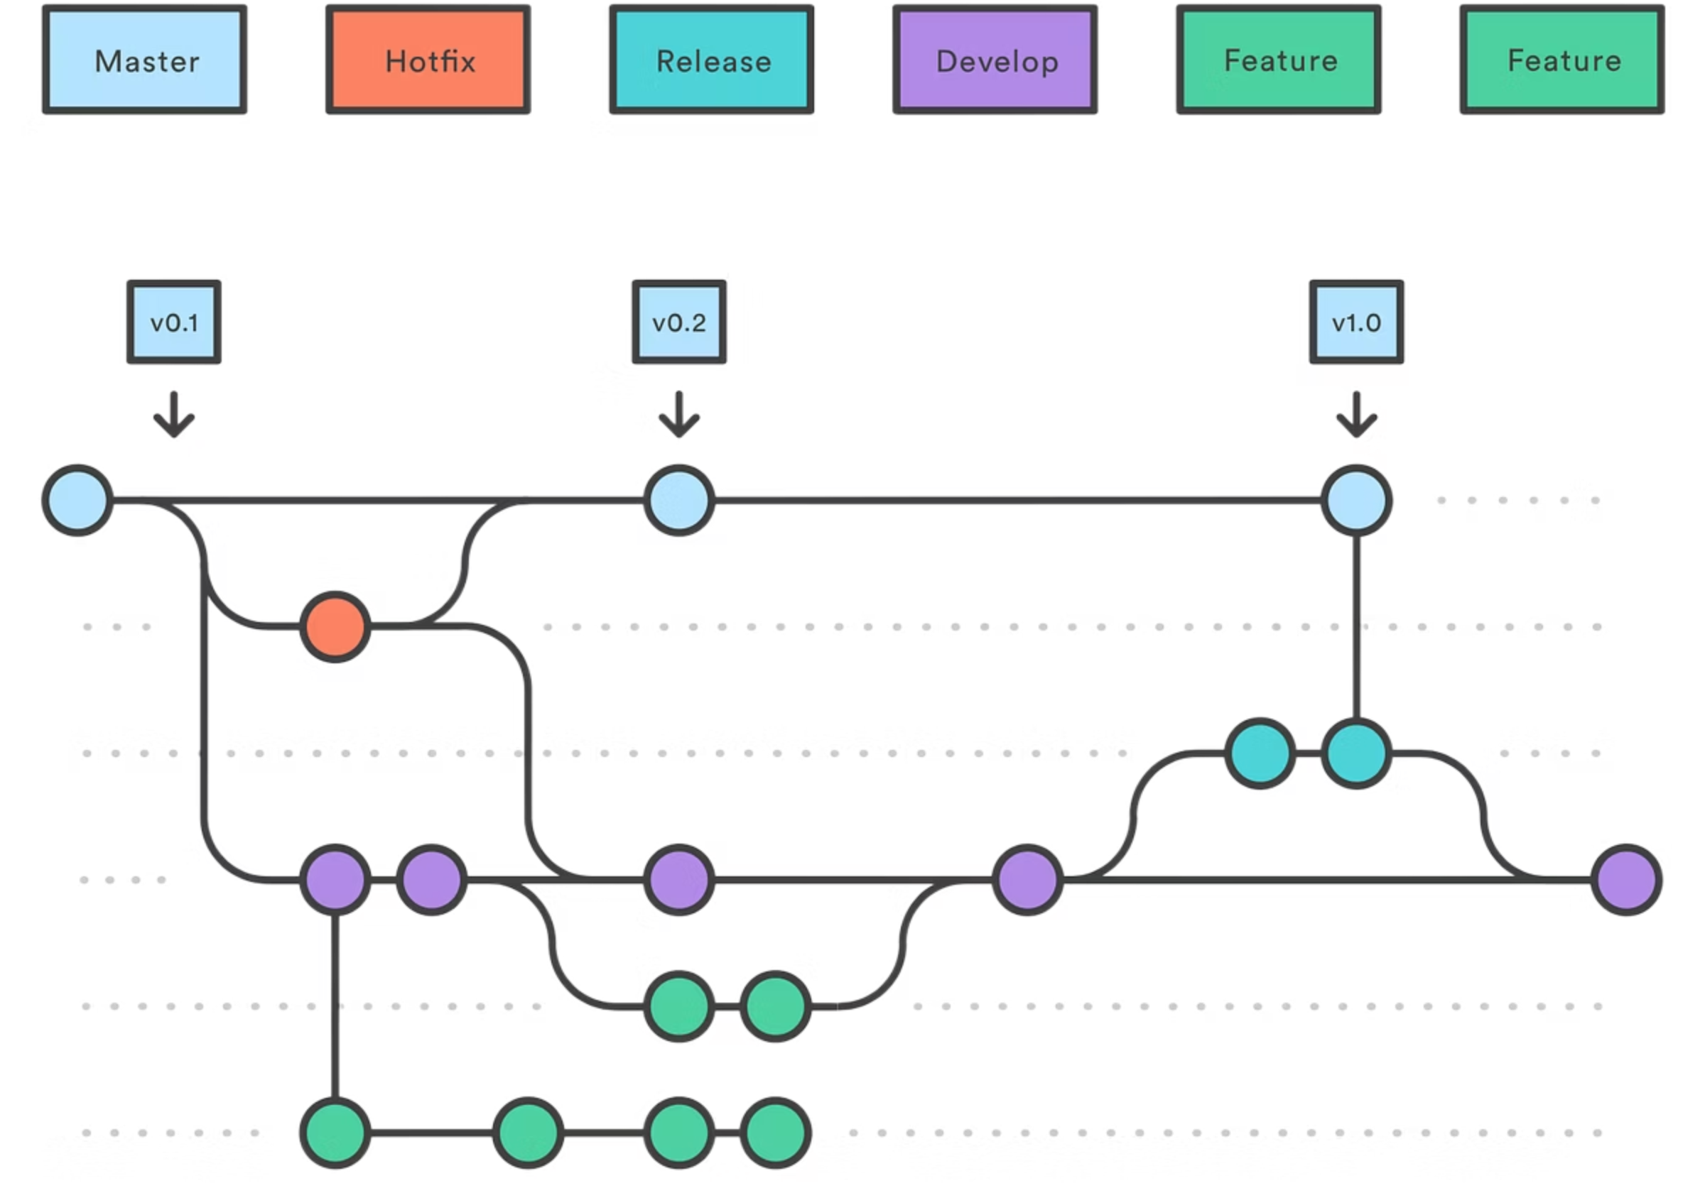
Going Beyond the Basics
Master sophisticated Git workflows for complex projects and seamless team collaboration.

Slide 3
Quick Recap
Git Fundamentals
Why Go Advanced?
Git is a distributed version control system that tracks changes in your codebase. Unlike centralised systems, every developer has a complete copy of the project history.
Complex workflows, large teams, and enterprise projects require sophisticated Git strategies beyond basic commands.
Repository: Project container
Commit: Snapshot of changes
Branch: Independent line of development
Merge: Combining changes

Slide 4
How Git Stores Data
Blob Objects
Tree Objects
Store file contents as compressed binary data. Each file version gets its own blob with unique SHA-1 hash.
Directory structure mapping filenames to blobs. Trees can contain other trees, creating hierarchical structure.
Commit Objects
Tag Objects
Point to tree objects plus metadata: author, timestamp, parent commits, and commit message.
Named references to specific commits, typically used for releases and version markers.
References like HEAD, branches, and tags are simply pointers to these objects, creating a directed acyclic graph of project history.

Slide 5



Branching Models
Git Flow
Structured approach with dedicated branches for features, releases, and hotfixes. Ideal for scheduled releases and larger teams.
Feature branches from develop
Release branches for testing
Hotfix branches for urgent fixes
Trunk-Based Development
Small, frequent commits directly to main branch. Supports continuous integration and rapid deployment cycles.
Short-lived feature branches
Feature flags for incomplete work
Automated testing essential
Choose your strategy based on team size, release frequency, and project complexity.

Slide 6
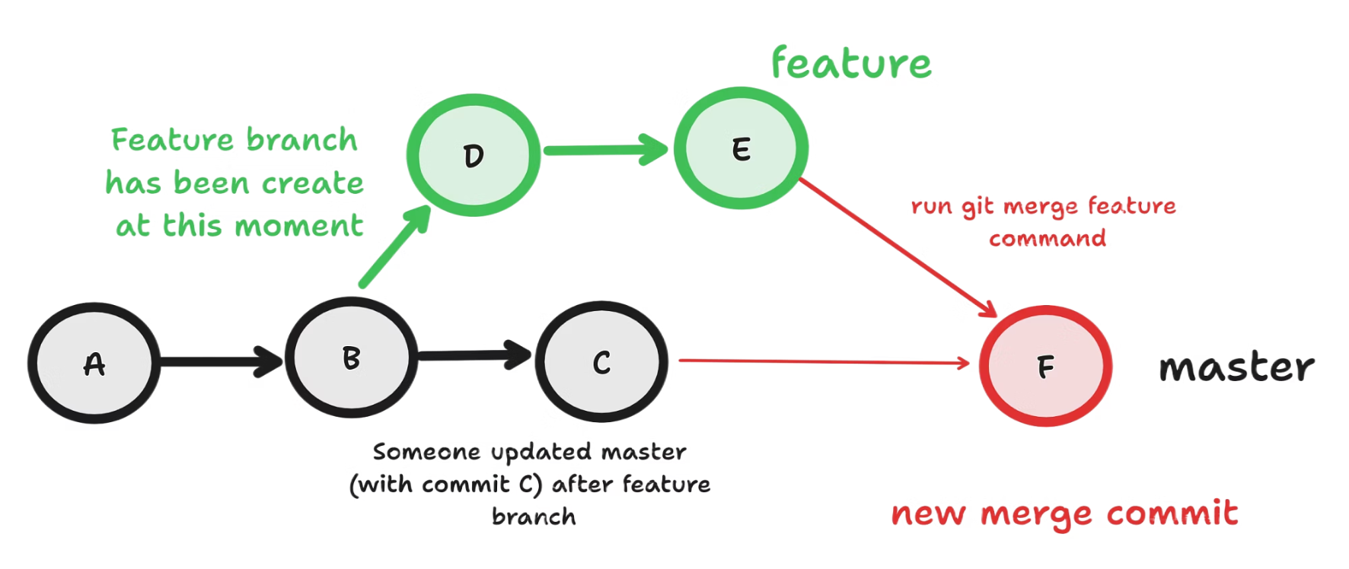
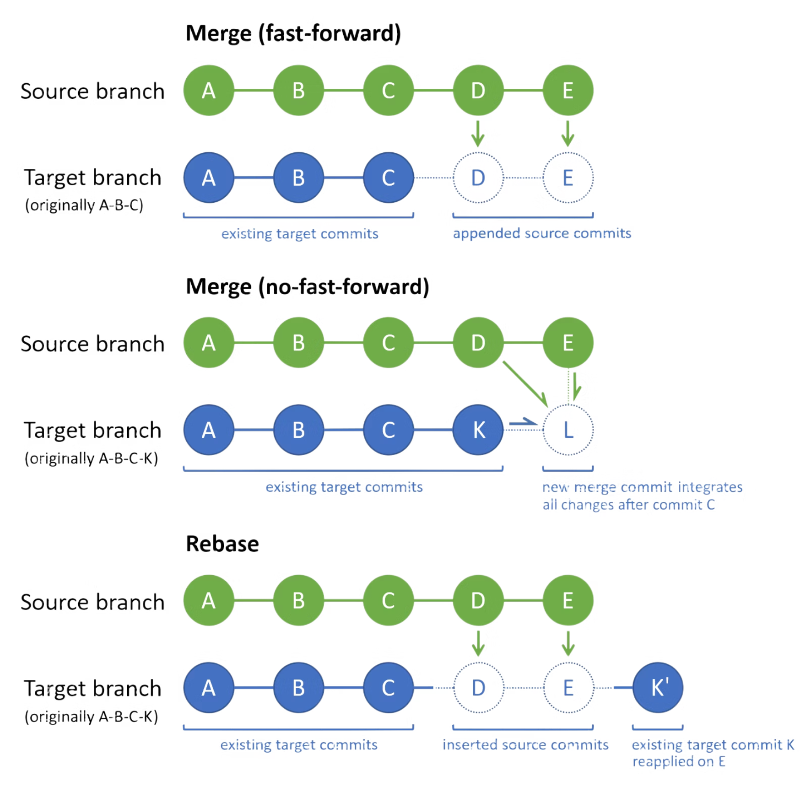
Rebase vs Merge
Merge Strategy
Rebase Strategy
Preserves History
Creates merge commits
Shows true project timeline
Safe for shared branches
Best for: Collaborative projects where history matters
⚠️ Golden Rule
Never rebase commits that have been pushed to shared repositories. You'll rewrite history others depend on.
Rewrites History
Creates linear commit history
Cleaner project timeline
Easier to follow changes
Best for: Private branches before pushing

Slide 7
Managing Work in Progress
01
02
03
Stash Your Changes
Switch Contexts
Restore Your Work
git stash temporarily saves uncommitted work, allowing you to switch branches without losing progress.
Work on different branches, pull updates, or handle urgent fixes without committing incomplete work.
git stash pop restores changes and removes from stash. Use git stash apply to keep the stash.
Use git clean -f to remove untracked files. Add -d for directories and -x for ignored files too.

Slide 8




Applying Specific Changes
Cherry-Pick Commands
git cherry-pick <commit-hash>
git cherry-pick <start>..<end>
git cherry-pick --no-commit <hash>
Apply commits from one branch to another without merging entire branch history.
Bug Fix Application
Selective Feature Migration
Apply critical bug fixes to production branches without merging unfinished features from development.
Move specific improvements or changes between branches when full merges aren't appropriate.
Best practice: Only cherry-pick small, isolated commits to avoid conflicts and maintain code integrity.

Slide 9
Managing External Repositories
1
Multiple Remotes
Configure origin (your fork) and upstream (original repo) to stay synchronised with project updates.
2
Fetching Updates
Regularly fetch from upstream repositories to incorporate latest changes without automatic merging.
3
Submodule Integration
Include external Git repositories as subdirectories, perfect for shared libraries and dependencies.
Submodules maintain their own Git history whilst being referenced by the parent project at specific commit versions.
Example use case: A web application project including a shared UI component library as a submodule.

Slide 10
Automating with Git Hooks
Client-Side Hooks
Enforce Standards
Quality Gates
pre-commit: Run before commit
Validate commit message format and coding standards before allowing commits.
Run automated tests and security scans before pushing to shared repositories.
pre-push: Run before push
commit-msg: Validate messages
Server-Side Hooks
CI/CD Integration
pre-receive: Before accepting push
Trigger deployment pipelines and notification systems after successful commits.
update: Per-branch validation
post-receive: After successful push

Slide 11




Tips for Effective Git Usage
Clear Commit Messages
Write descriptive messages following conventional formats. Include what changed and why it matters.
Atomic Commits
Keep commits small and focused on single changes. Makes debugging and reviewing much easier.
Security Awareness
Never commit secrets, API keys, or large binary files. Use .gitignore and environment variables.
Visual Tools
Use git log --oneline --graph --decorate for terminal visualization or GUI tools like GitKraken.
Master these advanced concepts and you'll handle complex Git workflows with confidence and precision.

Slide 12

Thank You
www.herovired.com
Wait Nahi, Great Kar!

